Slide 1
Football Coaching Aid
Project Description
The aim of this project is to provide football coaches with an aid to best predict future play performance. In doing so, a football coach will have better insight into the success of the up coming play.
John Rivas
Chris Bowes

Slide 2
Data NFL Play-by-Play Dataset
Data set consists of each NFL (National Football League) play ran in each game from 2009 to 2016.
There are 327,006 observations in the dataset.
There are 61 variables that describe different aspects of a play like; game clock, field position, teams playing and others.
However, only 18 variables will be considered for analysis.
Predictors and responses
All variables known before the play are predictors
All variables known only after the play are responses
The variable “Play Type” will be considered both depending on analysis

Slide 3
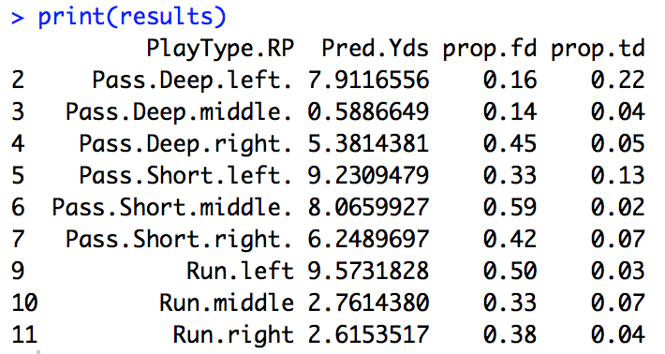
Project Goals
The variable “Play Type” will be considered an “option” variable since it’s the only one a coach has the option to change.
Predict “Play Type” by creating a classification model on variables known before the play. (multinomial classification)
Predict, by play type, “First Down” by creating a classification model on variables known before the play and “play type”. (binomial classification)
Predict, by play type, “Touchdown” by creating a classification model on variables known before the play and “play type”. (binomial classification)
Predict, by play type, “Yards Gained” by forecasting on variables known before the play and “play type”. (forecast)
Predict, for only pass plays, “Reception” with classification model. (binomial classification)

Slide 4
Preprocessing
The data set includes all plays including kickoffs, timeouts and penalties.
Only plays that are “run” or “pass” will be considered.
After removing unwanted plays, there are 222,530 that will used in analysis.
Categorical data was processed to integers.
Training and testing sets were created for each predicted variable.

Slide 5
Training & Results
Football Coaching Aid

Slide 6
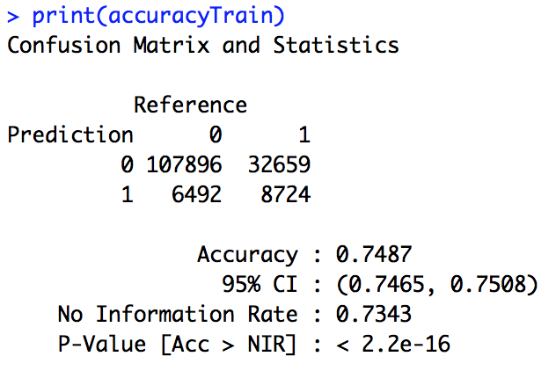
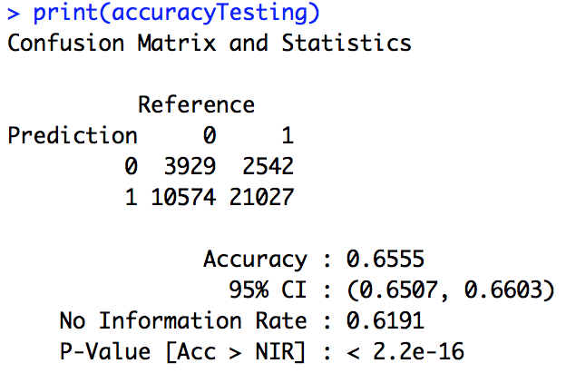
First Down Models and Results Logistic Regression

Slide 7
First Down Models and Results Logistic Regression - Class Imbalance
Area under the curve: 0.577 Area under the curve: 0.6627

Slide 8
First Down Models and Results cont. Decision Tree
Decision tree
Testing Accuracy : 0.762
Confusion Matrix on Testing

Slide 9
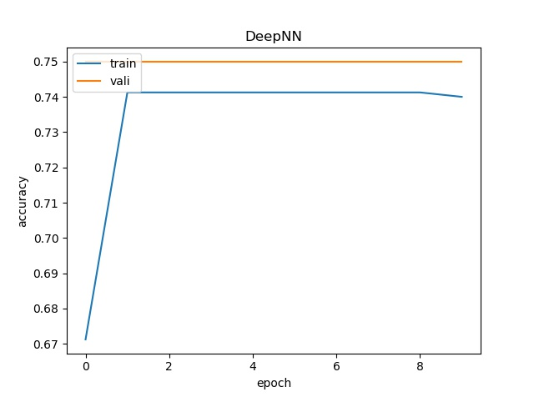
First Down Models and Results cont. Deep Learning
Deep learning
Only ran with limited number of observations
Training accuracy = 74%
Validation accuracy = 75%

Slide 10
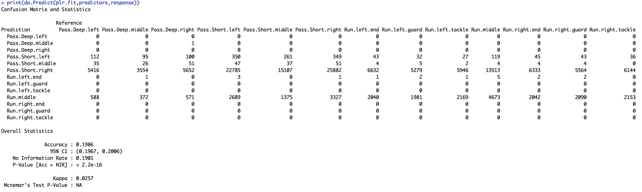
Play Type Models and Results Multinomial Regression

Slide 11
Play Type Models and Results cont. Decision Tree
Decision tree
Testing Accuracy :
Confusion Matrix on Testing

Slide 12
Play Type Models and Results cont. Deep Learning

Slide 13
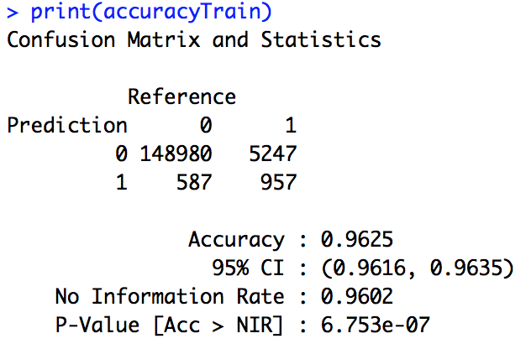
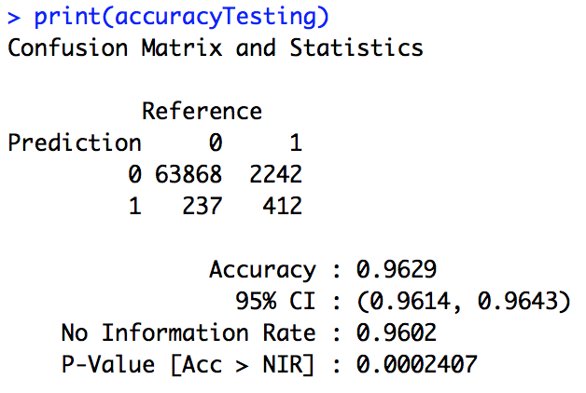
Touchdown Models and Results Logistic Regression

Slide 14
Touchdown Models and Results Logistic Regression – Class Imbalance
Area under the curve: 0.5752 Area under the curve: 0.8166

Slide 15
Touchdown Models and Results cont. Decision Tree
Decision tree
Testing Accuracy :
Confusion Matrix on Testing

Slide 16
Touchdown Models and Results cont. Deep Learning

Slide 17
Yards Gained Models and Results Linear Regression

Slide 18
Yards Gained Models and Results cont. Decision Tree
Decision tree
Testing Accuracy : 0.
Confusion Matrix on Testing

Slide 19
Yards Gained Models and Results cont. Deep Learning

Slide 20
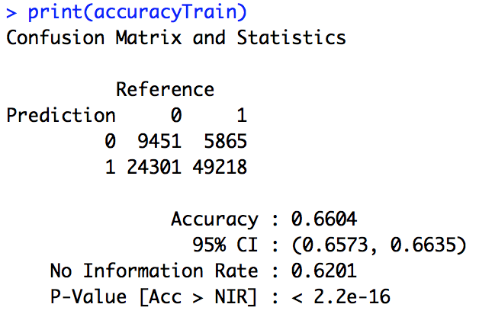

Reception Models and Results Logistic Regression

Slide 21
Reception Models and Results Logistic Regression – Class Imbalance
Area under the curve: 0.5868 Area under the curve: 0.6045

Slide 22
Reception Models and Results cont. Decision Tree
Decision tree
Testing Accuracy : 0.
Confusion Matrix on Testing

Slide 23
Reception Models and Results cont. Deep Learning

Slide 24
Future Direction
Get more granular detail of offensive and defensive
Who played each position on each play
Formation and plays ran
NFL is collecting spatial-temporal data on players.
Players wear RFID tags in shoulder pads and helmets
Collects data on player location, direction and momentum before and during the play.
In addition, feedback from a football coach would be needed to determine direction of future research.

